Slide 1
专业外语
软件工程 物联网
2023-7-1

Slide 2
PART 3 PROGRAMMING LANGUAGES AND DATABASES CHAPTER 7 DATABASE 7.1 DATABASE CONCEPTS

Slide 3
KEYWORDS
database 数据库
DBMS (Data Base Management System) 数据库管理系统
relational database 关系型数据库
field 字段
record 记录
file 文件
ID (Identification) 标识，识别，身份证
table 表
data item 数据项

Slide 4
table view 表格视图
data sheet 数据单，数据表
form 表格，表单
query 查询
directional key 定向键
blank record 空记录
menu bar 菜单栏

Slide 5
People often need to retrieve large amounts of data rapidly.
An airline agent on the phone to a client may need to search quickly to find the lowest-cost flight from Atlanta to Toronto.
The registrar of a university may have to scan student records swiftly to find all students who will graduate in June with a grade-point average of 3.5 or higher.

Slide 6
A clerk in a video store may need to determine if a particular movie is available for rental.
The type of software used for such tasks is a database management system.
Computerized database management systems are rapidly replacing the paper-based filing systems that people have had to wade through in the past to find the information their jobs require.

Slide 7
The basic features and concepts of PC-based relational database software are discussed next, using Microsoft Access as an example when needed.

Slide 8
1. What Is a Database Program
A database is a collection of data that is stored and organized in a manner enabling information to be retrieved as needed.
A database management system (DBMS)—also sometimes called just database software—enables the creation of a database on a computer and provides easy access to data stored within it.

Slide 9
Although not all databases are organized identically, most PC-based databases are organized into fields, records, and files.
A field is a single type of data to be stored in a database, such as a person’s name or a person’s telephone number.
A record is a collection of related fields—for example the ID number, name, address, and major of Phyllis Hoffman (see Figure 7-1).

Slide 10
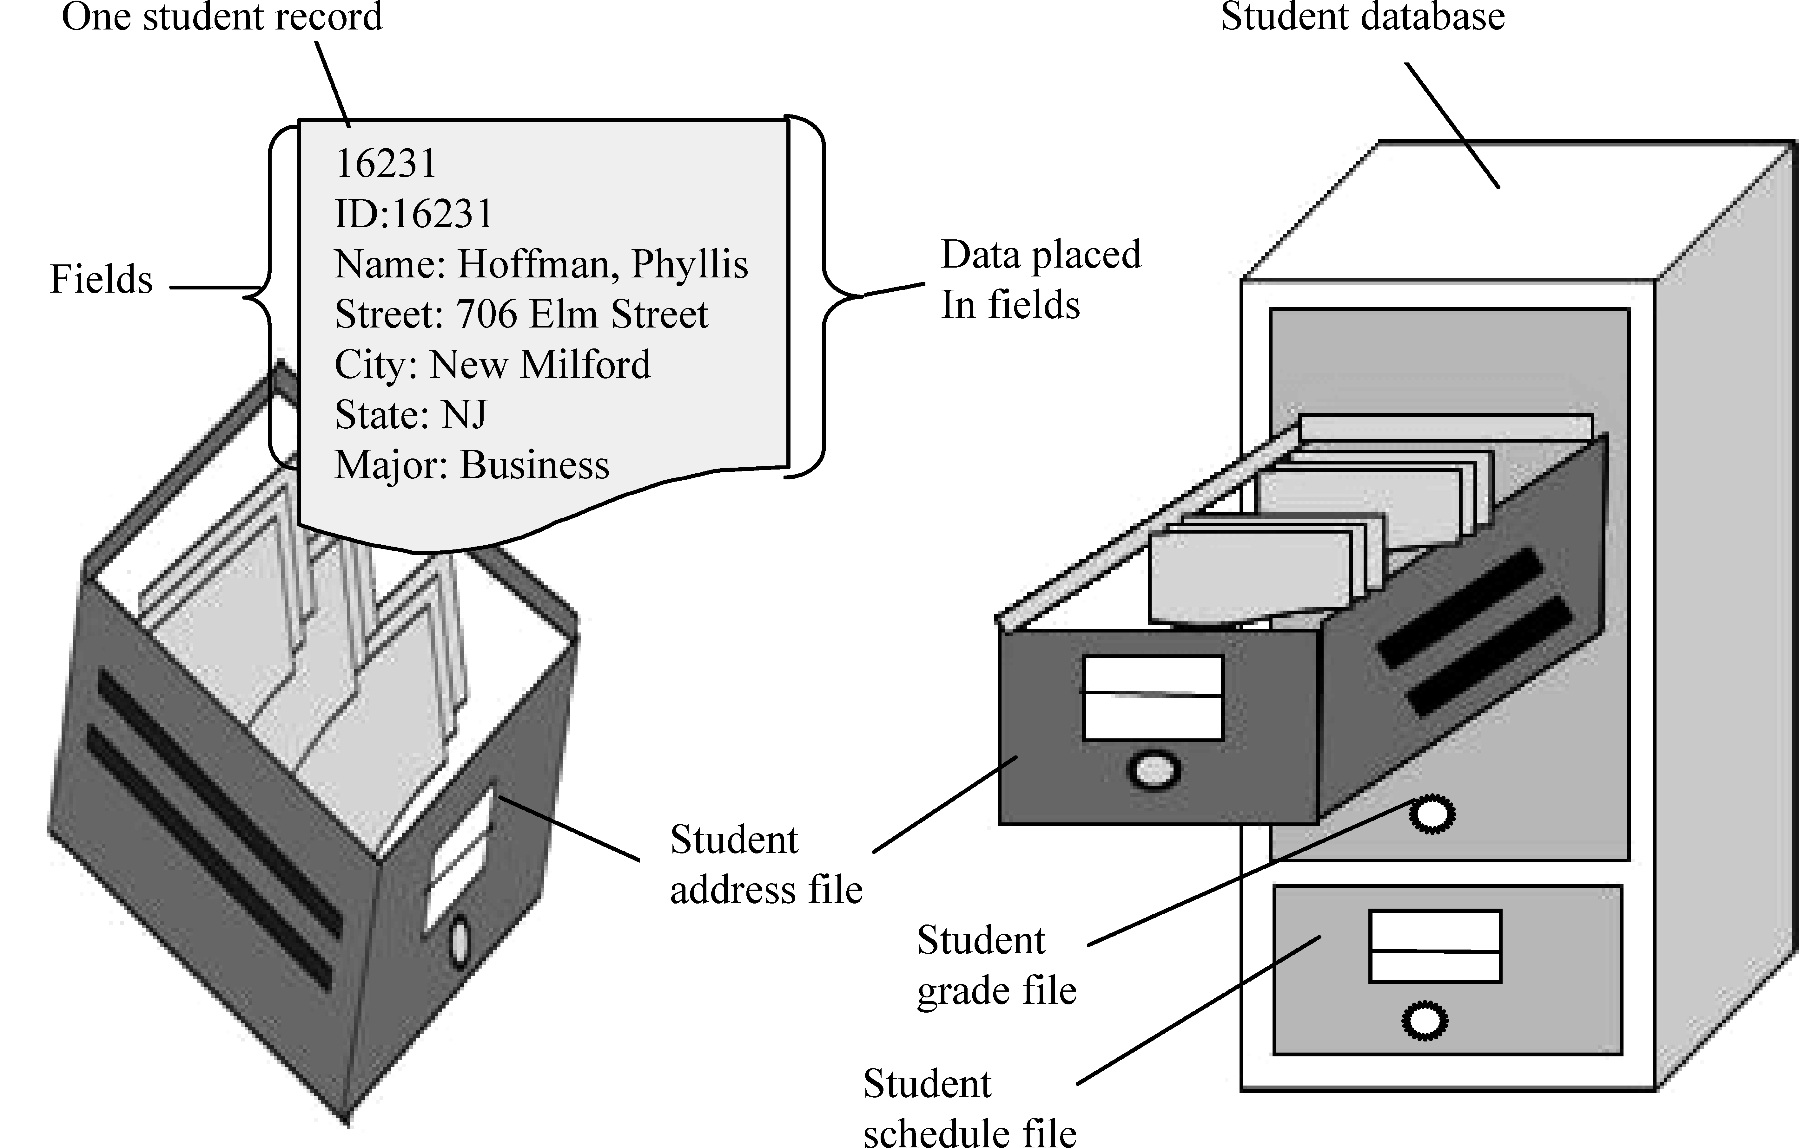
Figure 7-1 Fields, records, files, and databases. Fields, records, and files (tables) organize the data that are to be part of a database

Slide 11
A file—frequently called a table in PC databases—is a collection of related records (such as all student address data, all student grade data, or all student schedule data).
The resulting set of related files or tables (such as all student data) comprises the database.
The type of database software found on most PCs is the relational database management system.

Slide 12
2. Creating a Database
A database can contain a variety of objects (see Figure 7-2).
The object created first in a new database is the table, then other objects can be created to be used in conjunction with that table as needed.

Slide 13
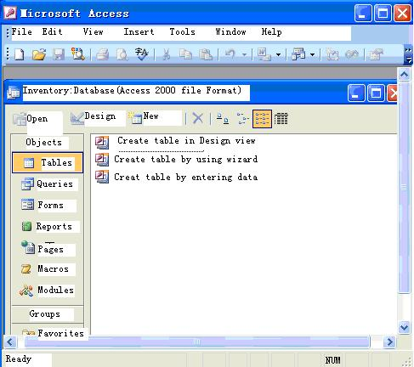
MENUS AND
TOOLBARS
Just as with
most other
programs, menus
and toolbar
buttons can be
used to issue
commands
DATABASE FILE
All of these objects
are stored within
the inventory file
One of these options
Can be selected to
create a new table
DATABASE OBJECTS
Common database
objects are tables
(for storing data),
forms (for viewing
table data),and
queries and reports(for
retrieving information
from a table)
Figure 7-2 A typical database program

Slide 14
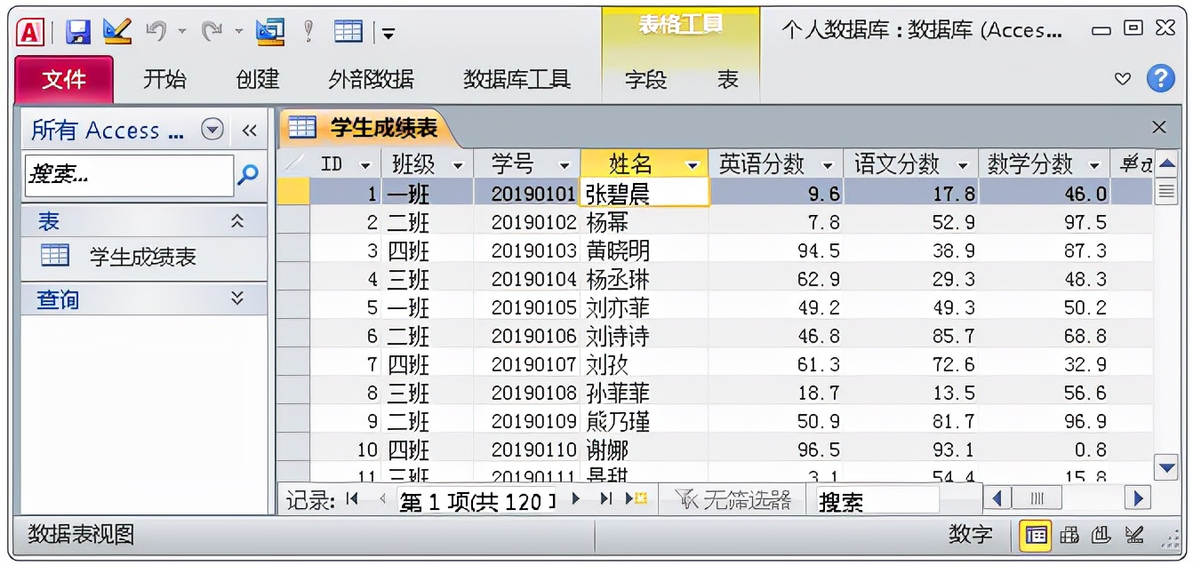
From the Internet

Slide 15
When creating a database, the number of tables to be included in the database should be determined.
Then the data items to be stored in each table can be identified so that the appropriate field characteristics can be used.

Slide 16
For each field, the following should be determined:
（1）Field name (an identifying name unique within the table)
（2）Type of data to be contained in the field (text, numbers, date, etc.)
（3）Field size (how many characters will be needed to store the data)
Once these specifications have been determined, the structure of each table containing the field specifications (see Figure7-3) can be created.

Slide 17
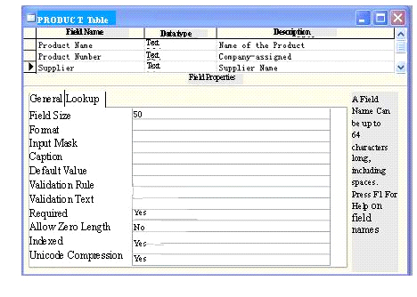
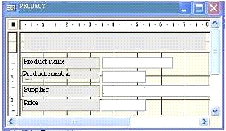
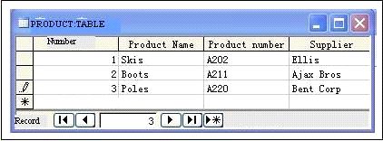
TABLE STRUCTURE
Each field is given name
and the size of the
field and type of
data to be entered into
the field are identified
Forms usually display one
record at a time. Records are
added by filling out the form
in the table datasheet view,
fields appear as columns,
and records appear as row
Figure 7-3 Creating a database

Slide 18
After the table structure has been created, data may be entered into the table.
Data entry can be performed in the regular table view—sometimes called the datasheet view, since the table looks similar to a spreadsheet—or a form can be created and used.

Slide 19
A form allows you to view or edit table content in a more formal manner—usually just working with one record at a time, instead of a full page of records, as in the datasheet view.
Figure 7-3 illustrates entering data using both methods once the table structure has been created.

Slide 20
3. Modifying a Database
Once a database table has been created, it may need to be modified.
Changes may be made to the table structure or to the data located in the table as needed.

Slide 21
（1）Modifying the Table Structure
The table structure needs to be modified only when there are changes to the field properties.
For example, a field may need to be widened to accommodate a name that is longer than anticipated, the wrong field type may have been initially selected, or a new field may need to be added.

Slide 22
（2）Editing, Adding, and Deleting Records
To make changes to the actual data in a table, the table must first be opened (either using the table datasheet view or a form), and then the necessary changes can be made.
To move to a particular record to edit its contents, either the arrows and other keyboard directional keys or the record buttons located at the bottom of the window, can be used (refer again to Figure 7-3).

Slide 23
From the Internet

Slide 24
Since records are typically added to the end of a table, there is usually a New Record button in the group of record buttons that automatically moves you to a blank record at the end of the table.
To delete a record, either the Delete key on the keyboard or some type of Delete Record option on the menu bar is used.

Slide 25
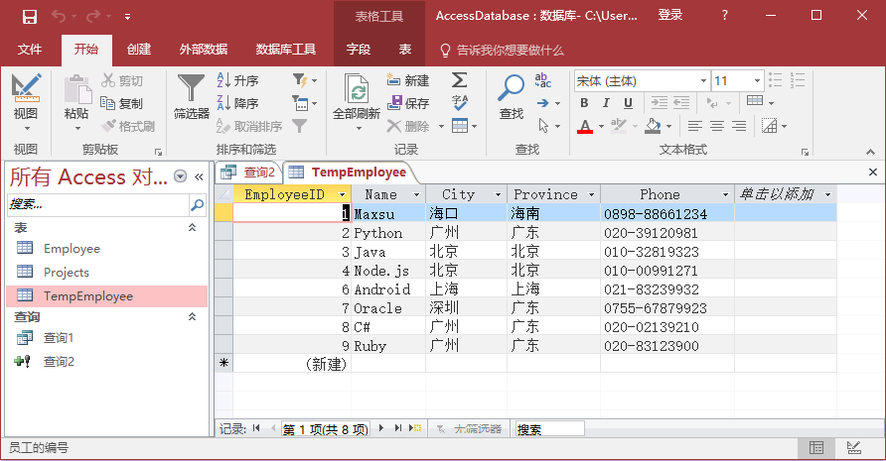
From the Internet

Slide 26
4. Queries and Reports
To retrieve information from a database, queries and reports are used.
A query is a question, or, in database terms, a request for specific information from the database.
A query takes your instructions about what information you want to find and displays just that requested information.
A report is a more formal printout of a table or query result.

Slide 27
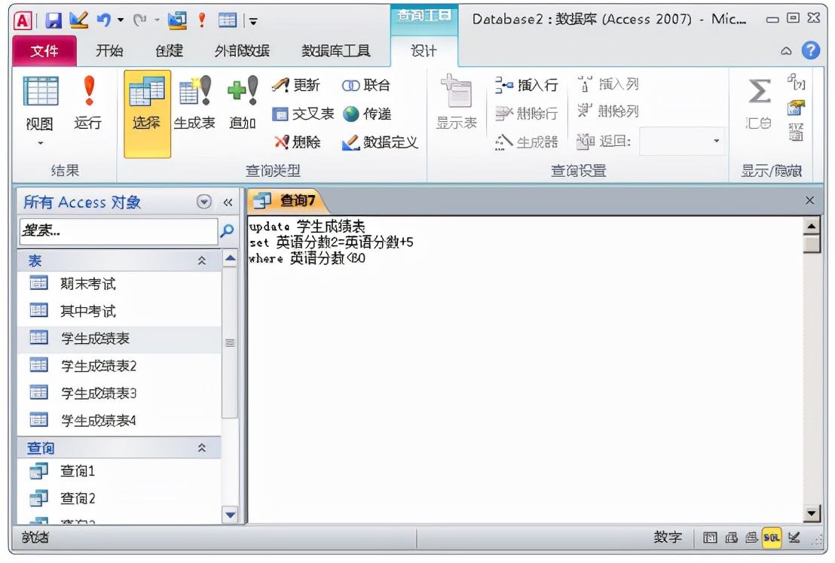

Slide 28
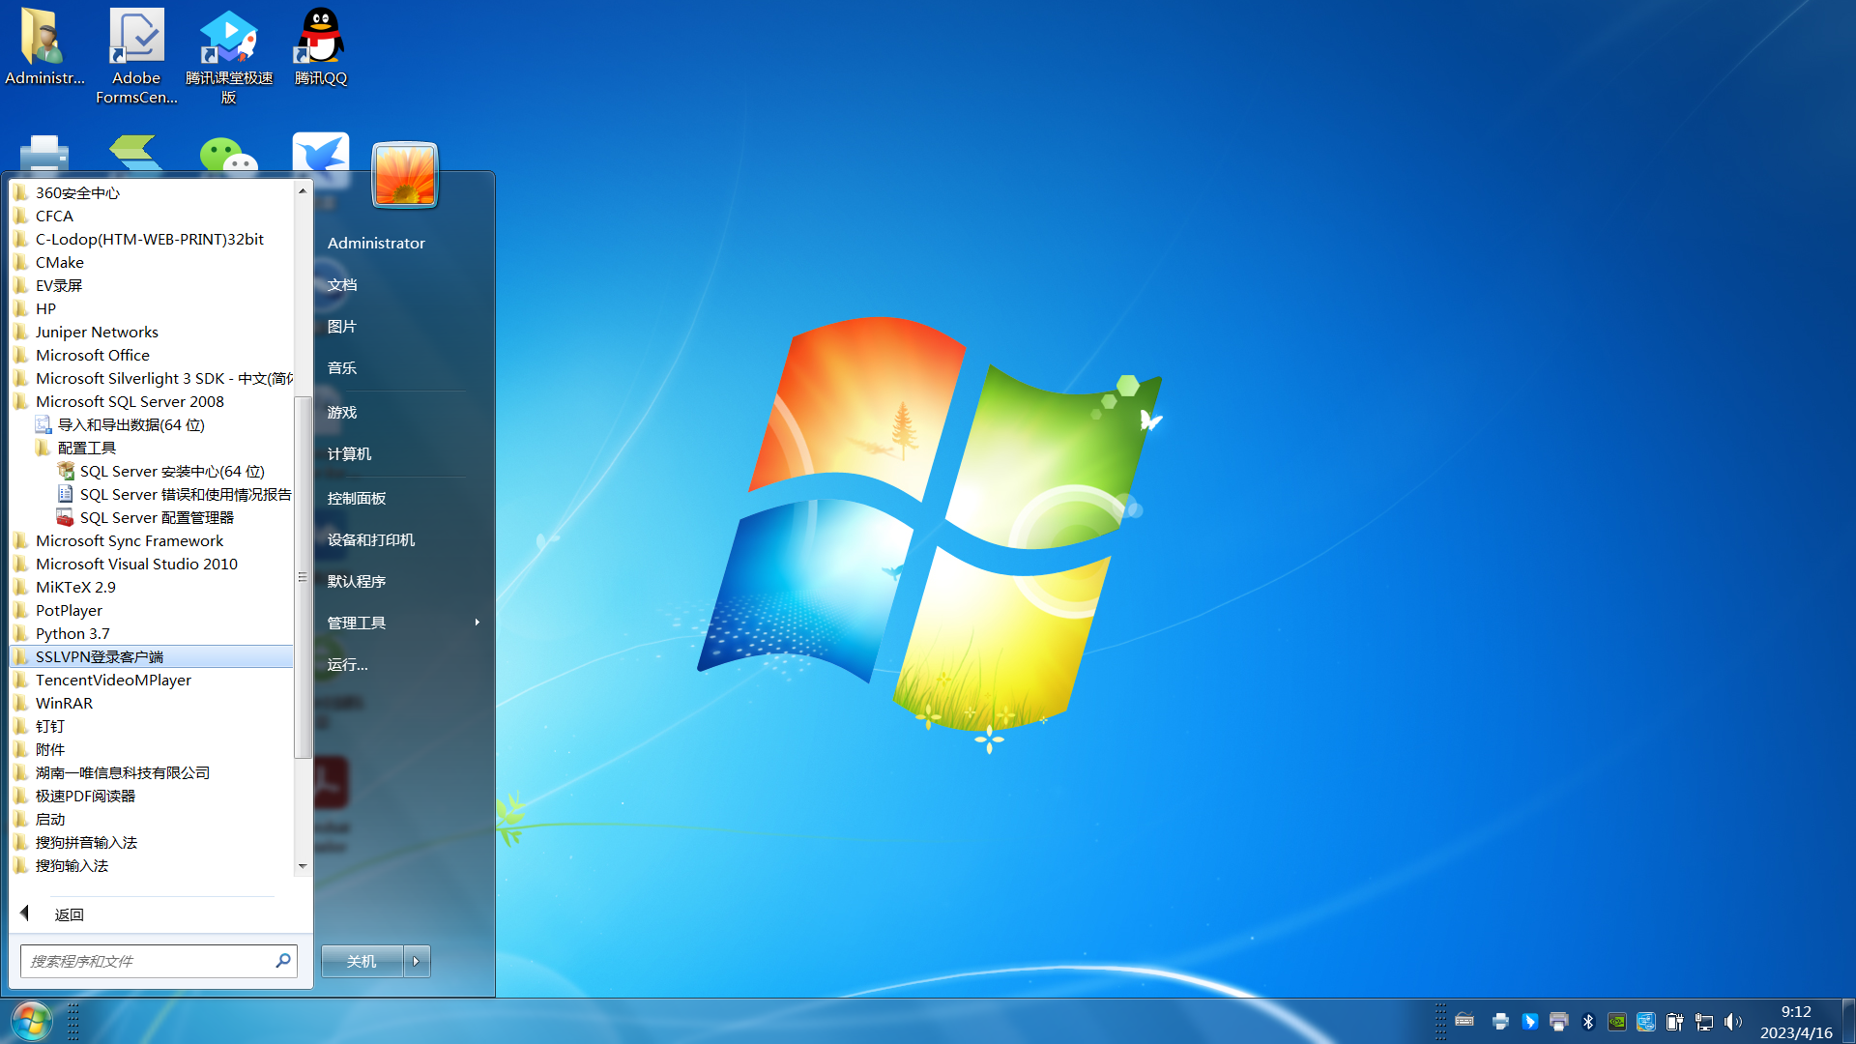
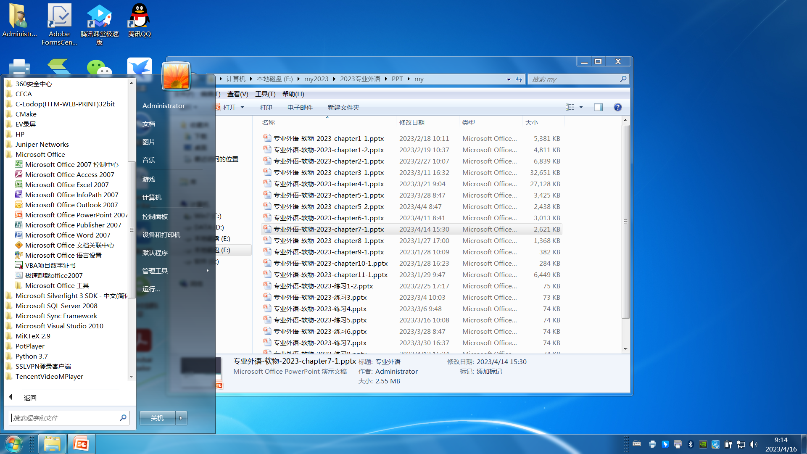

Slide 29
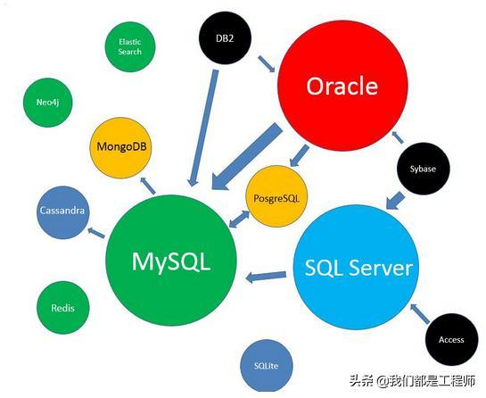
关系型数据库
relational database software
From the Internet

Slide 30
PART 3 PROGRAMMING LANGUAGES AND DATABASES CHAPTER 7 DATABASE 7.2 THE WEB DATABASES

Slide 31
KEYWORDS
online ordering 在线订货
peer-to-peer 对等的
retrieval 检索
script 脚本〔文件〕，稿本，过程
dynamic web page 动态网页
static web page 静态网页
form 表单，表格，窗体
database query 数据库查询
middle ware 中间件

Slide 32
CGI (Common Gateway Interface) 公用网关接口
API (Application Program Interface) 应用程序接口
PHP (Personal Home Page) 个人家庭主页
ASP (Active Server Page) 现用服务器页面，动态服务器主页

Slide 33
Databases are extremely common on the World Wide Web.
Virtually all companies that offer products or corporate information, online ordering, or similar activities through a Web site use a database.
The most common applications involve client-server database transactions, where the user’s browser is the client software.
The use of peer-to-peer information exchange, however, is increasing.

Slide 34
1. Examples of Web Databases in Use
There are scores of examples of how databases can be used on the Web.
Databases facilitate information retrieval and processing, as well as allow more interactive, dynamic content.
Following these sections is a discussion and example of how a Web database might work and a brief look at other Web-database-related issues.

Slide 35
(1) Information Retrieval
By their very nature, databases lend themselves to information retrieval on the Web, which is, in essence, a huge storehouse of data waiting to be retrieved.
Data is stored in the database, and Web site visitors can request and view it (see Figure 7-4).

Slide 36

Figure 7-4 Information retrieval and e-commerce

Slide 37
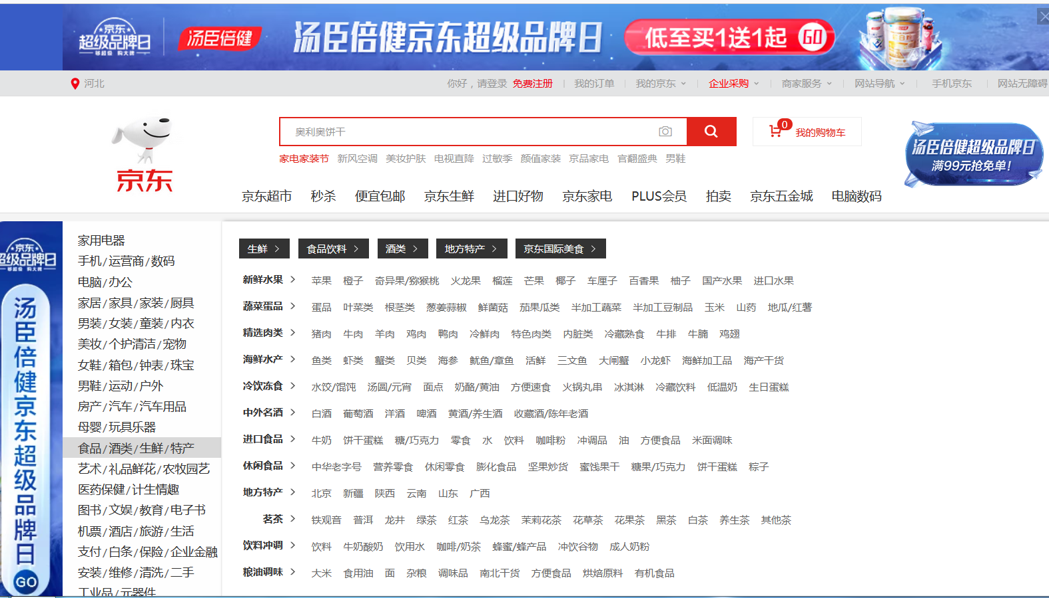
From the Internet

Slide 38
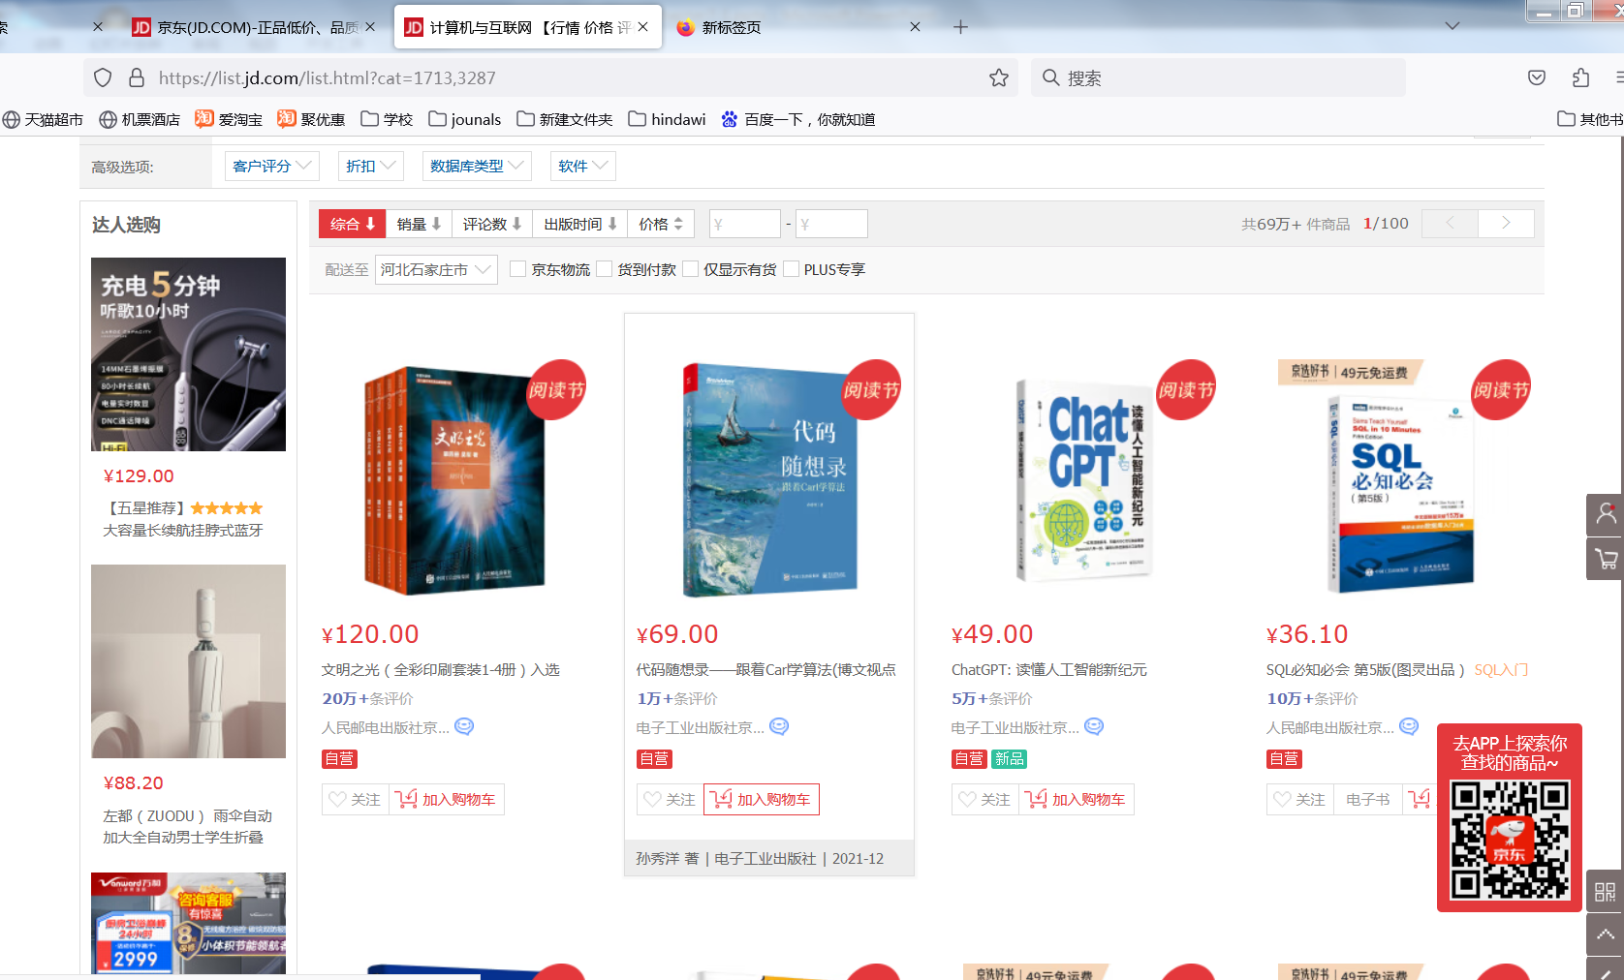
From the Internet

Slide 39
（2）E-Commerce and E-Business
Another widely used database application on the Web is to support and facilitate e-commerce.
Catalog information, pricing, customer information, shopping cart contents, and more can be stored in a database to be retrieved on demand using an appropriate script or program to link the database with the Web site. (refer again to Figure7-4).

Slide 40
（3）Dynamic Web Pages
Static Web pages display the same information for everyone, every time the page is displayed, until the Web page file is modified.
In contrast, the appearance and content of dynamic Web pages change based on a user’s input.
This input can be based on selections specified on a form located on the page or controlled by some other aspect, such as a Java applet, ActiveX control, or the activities that the user has already performed on the site, such as clicking a displayed ad or a product’s hyperlink.

Slide 41
2. How Web Databases Work
(1) An Example about Database and the Web Work Together
To further illustrate more about how databases and the Web can work together, let’s look at an example.
The request to retrieve information from or store data into a Web database is usually initiated by the user.
Filling out a Web page form, selecting an option from a menu displayed on a Web page, or clicking an onscreen are common ways database requests are made.

Slide 42
The request is received by the Web server, which then converts the request into a database query and passes it on to the database server with the help of intermediary software called middleware.
The database server retrieves the appropriate information and returns it to the Web server (again, via middleware) where it is displayed on the user’s screen as a Web page.
These steps are illustrated in Figure 7-5.

Slide 43
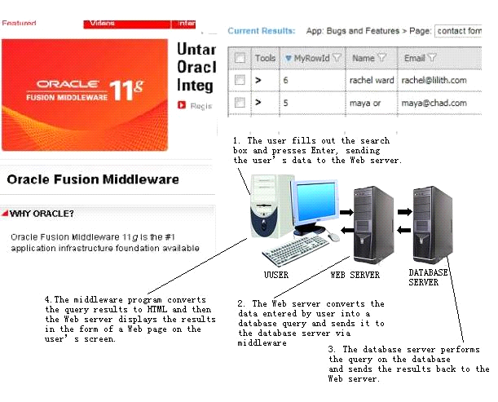
Figure 7-5 A Web database in action.

Slide 44
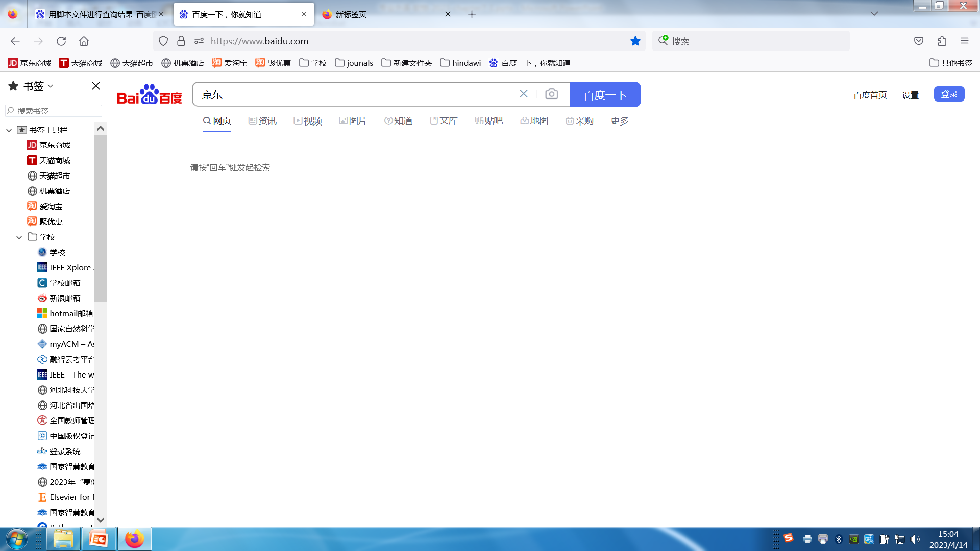
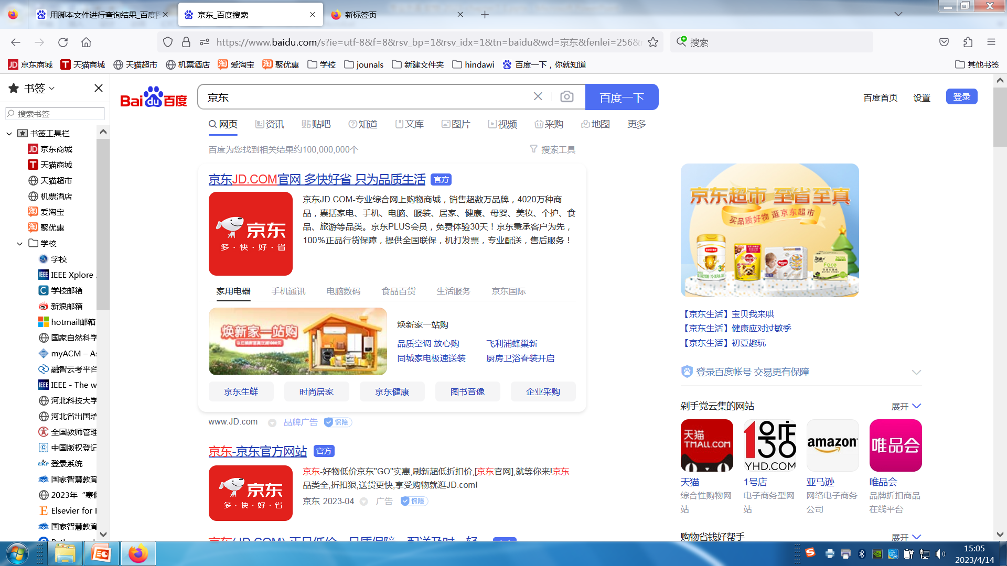

Slide 45
(2) Middleware
Software that connects two otherwise separate applications—such as a Web server and a database management system, as in Figure7-5—is referred to as middleware.
The most common types of middleware used to interface between a database and a Web page are CGI (Common Gateway Interface) and API ( Application Programming Interface) scripts.
A newer scripting language becoming increasingly more popular is PHP and ASP.

Slide 46
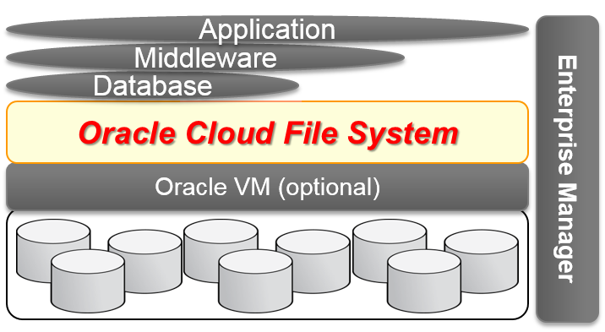
From the Internet

Slide 47
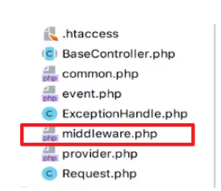

Slide 48
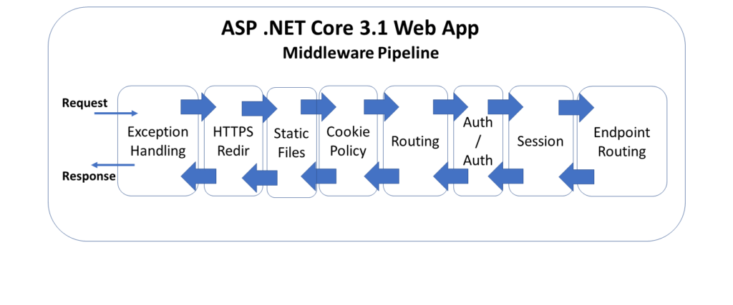
From the Internet

Slide 49
The End of this Section

